Slide 1


UNIT 1; Friends
Look back 1

Slide 2
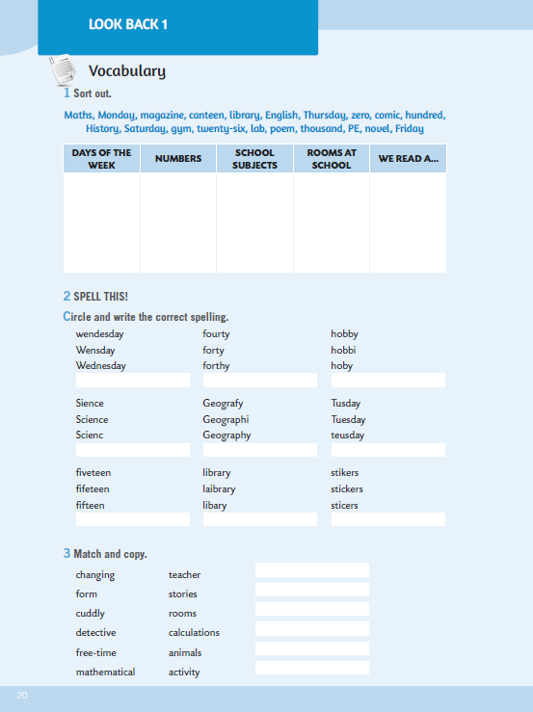
Open your exercise books, page 20.
Nakon svake nastavne teme u radnoj bilježnici se nalazi kutak za ponavljanje naučenog, ali i NOW I CAN kutak za samoprocjenu vlastitog napretka.
Zadaci za ponavljanje su podijeljeni u 5 kategorija:
Vocabulary (naučeni rječnik),
Language at work (jezični sadržaji – gramatika),
Reading (čitanje s razumijevanjem),
Listening (slušanje s razumijevanjem) i
Speaking (govorenje).
Pogledaj zadatke na sljedeće četiri stranice i probaj odrediti koliko si napredovao.

Slide 3
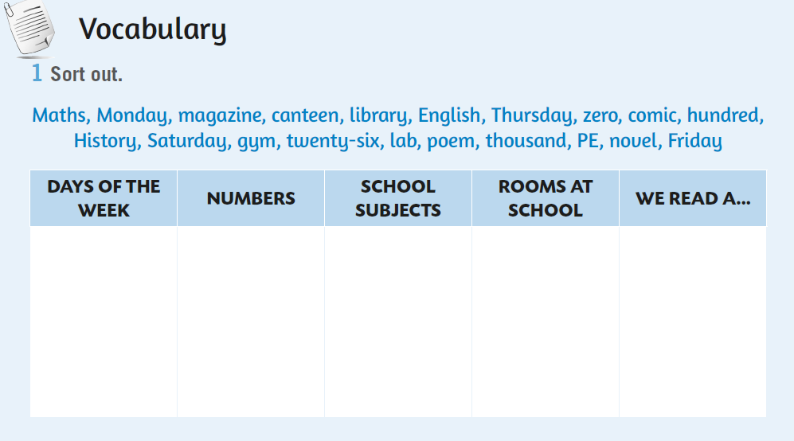
In task 1, you need to sort out the words.
U 1. zadatku moraš razvrstati riječi po kategorijama.
Monday
zero
Maths
canteen
magazine

Slide 4
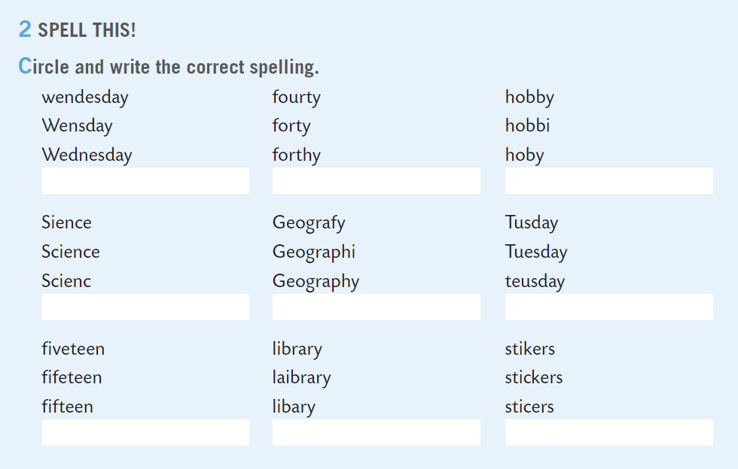

Next task deals with spelling. You have to circle and write the correct spelling.
Practice here:
https://www.e-sfera.hr/dodatni-digitalni-sadrzaji/7b9b9673-26f2-4fc7-8842-3c93a1ab2120/assets/interactivity/kviz_1/index.html
Wednesday

Slide 5
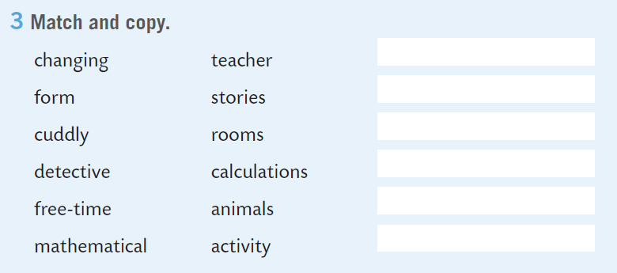
Match and copy the expressions in task 3.
1
changing rooms
1

Slide 6
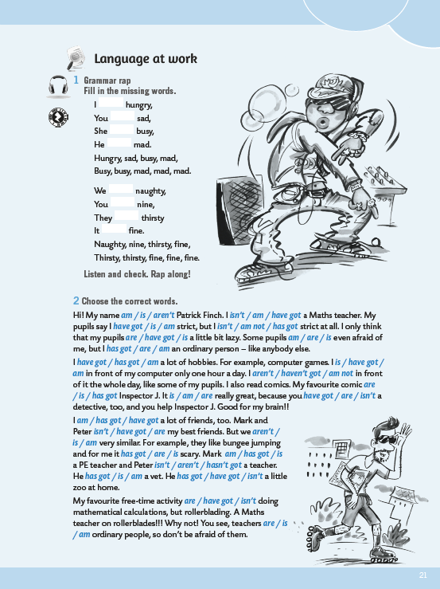
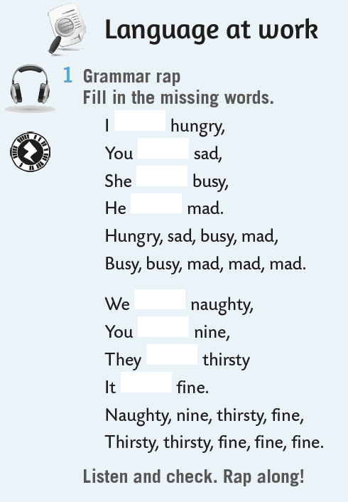

am
On the next page we will revise grammar.
Fill in the missing words.
Practice here:
https://www.e-sfera.hr/dodatni-digitalni-sadrzaji/7b9b9673-26f2-4fc7-8842-3c93a1ab2120/assets/audio/look_back_1_grammar_rap.mp3
are
is
is
are
are
are
is

Slide 7
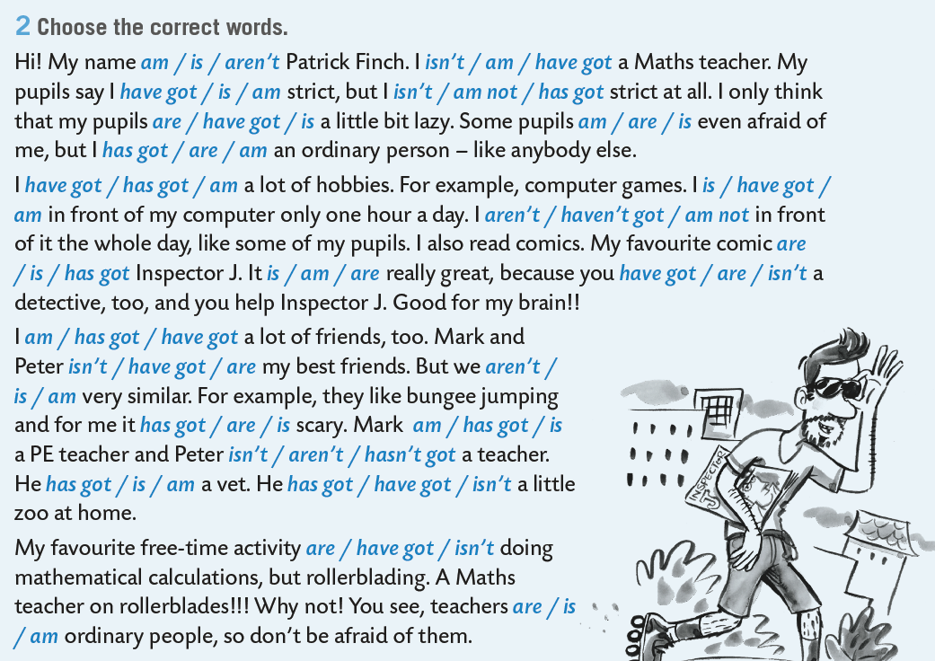
Choose the correct words in the next task.

Slide 8
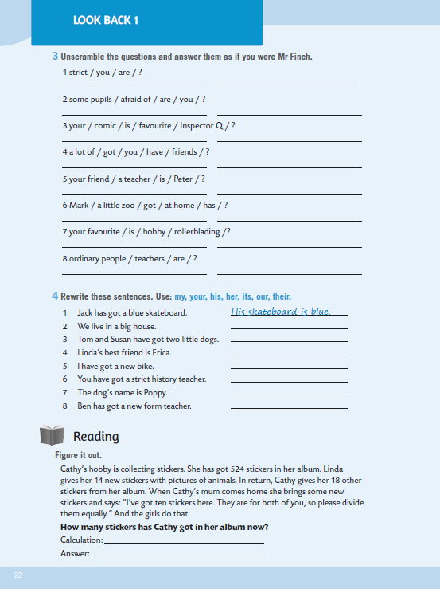
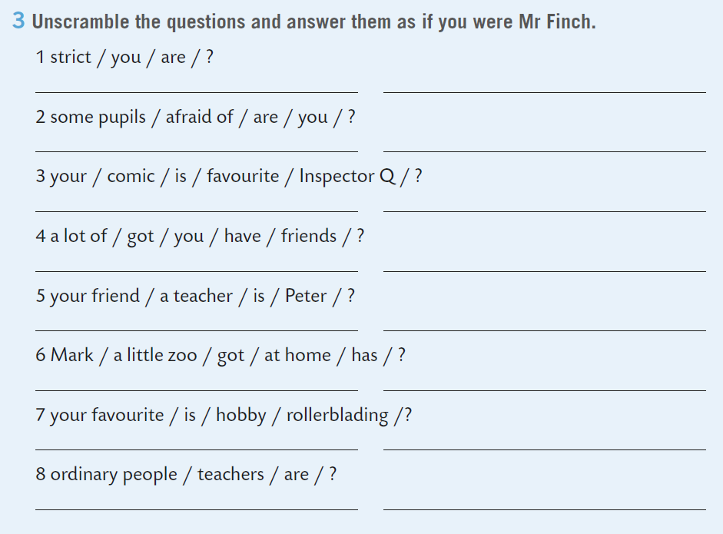
Unscramble the questions in task 3,page 22, and answer them as if you were Mr Finch.
Are you strict?
No, I’m not.

Slide 9
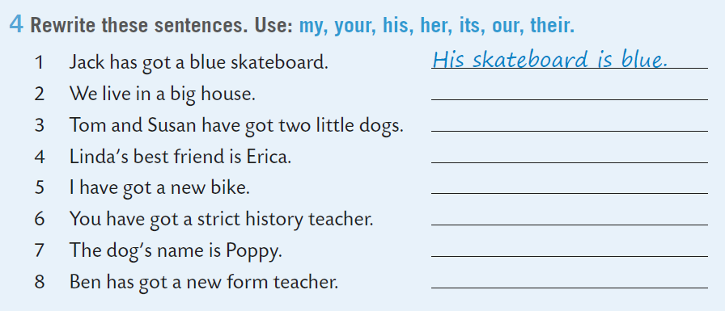
Rewrite the sentences in task 4. Use possessive adjectives.
Their house is big.

Slide 10
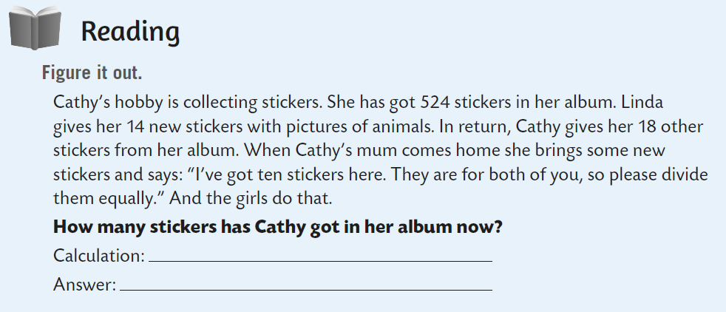
Read the text and figure out how many stickers has Cathy got in her album.
524 + 14 -18 …

Slide 11
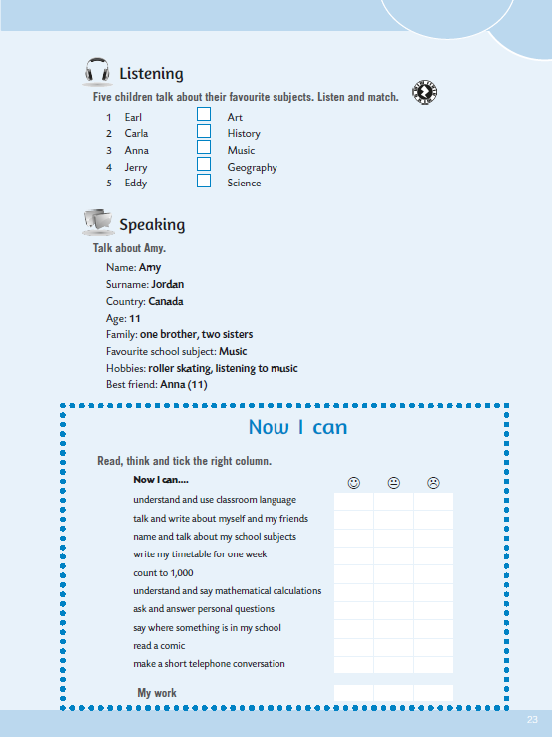
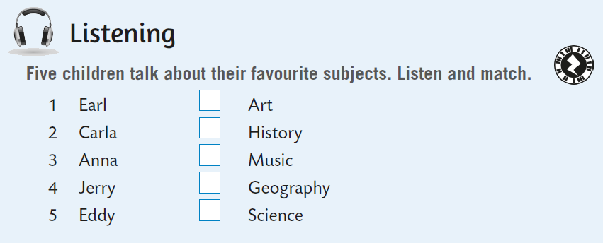
In the listening section on p. 23, five children talk about their favourite subjects. Listen and match.
https://www.e-sfera.hr/dodatni-digitalni-sadrzaji/7b9b9673-26f2-4fc7-8842-3c93a1ab2120/assets/audio/look_back_1a_five_children.mp3
1

Slide 12
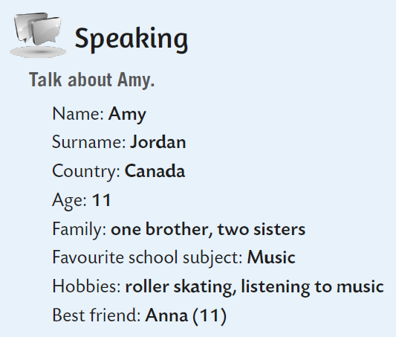
Look at the information in the speaking section. Call one of your friends from class and talk to him/her about Amy.

Slide 13
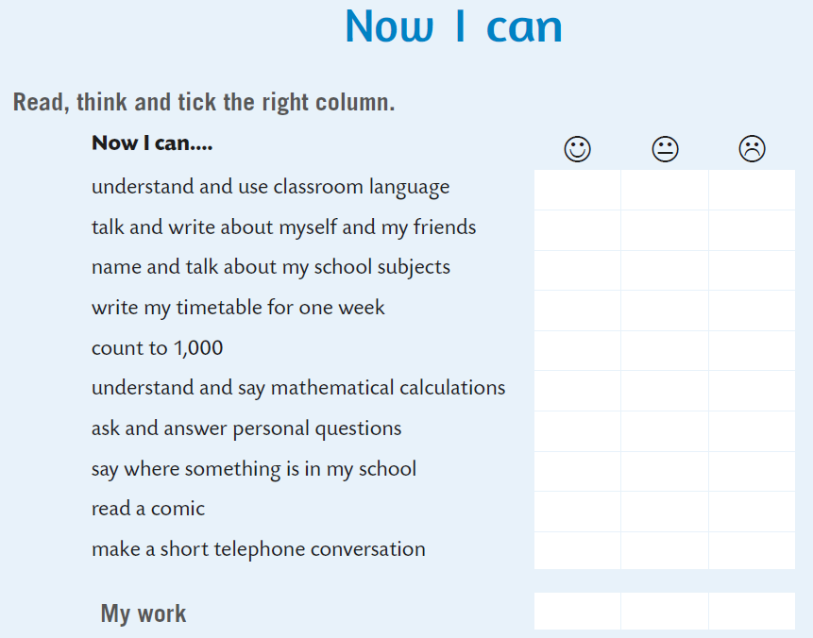



Now you can slef-evaluate. Read the sentences, think and tick the right column.
- razumijem i koristim razredni jezik
- govorim o sebi i svojim prijateljima
- imenujem nast. predmete i govorim o njima
- pišem svoj raspored za jedan tjedan
- brojim do 1000
- razumijem i izgovaram matematičke izraze
- postavljam osobna pitanja i dajem odgovor
- govorim gdje se što u školi nalazi
- čitam strip
- obavljam kratak telefonski razgovor

